Slide 1
JavaScript – Continued..
Instructor: Manu Peethambar
E-mail: cm13055@umbc.edu
Telegram handle: @manupeethambar888
Slides: https://github.com/manupeethambar888/webdev

Slide 2
JavaScript Number Methods
JavaScript Numbers
https://www.w3schools.com/js/js_numbers.asp
Number methods help you work with numbers.
https://www.w3schools.com/js/js_number_methods.asp

Slide 3
JavaScript Arrays
JavaScript arrays are used to store multiple values in a single variable.
https://www.w3schools.com/js/js_arrays.asp
JavaScript Array Methods
https://www.w3schools.com/js/js_array_methods.asp

Slide 4
JavaScript Sorting Arrays
https://www.w3schools.com/js/js_array_sort.asp
JavaScript Array Iteration Methods
Array iteration methods operate on every array item.
https://www.w3schools.com/js/js_array_iteration.asp

Slide 5
Exam 2 – 7/16/2018 (Monday)
Study all slides on Cascading Style Sheets(CSS):
https://github.com/manupeethambar888/webdev
Practice all the concepts taught on www.w3schools.com try it editor.

Slide 6
Assignment 14 due – 7/16/2018
Create a sample html file.
Go to the next slide for the question.
Save this as “assignment14.html” in Homework folder in your GitHub repository “Assignments_yourname”.
Commit and push the changes to the repository.

Slide 7
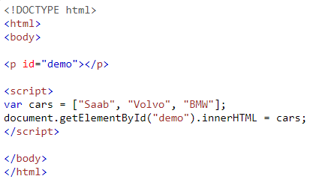
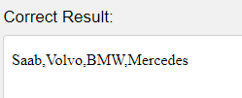
Assignment 14 due – 7/16/2018
Use the length property to add a new item to cars: Mercedes.

Slide 8
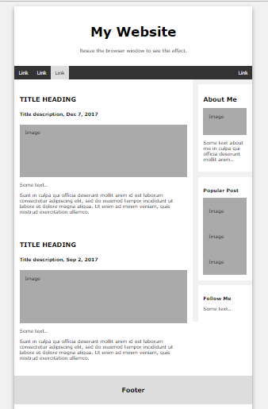
Project Assignment
You have to save the below assignment in your project folder.
Replace the text and fill your relevant information into the elements in index.html

